Slide 1
The Battle of Neighbourhoods
Choosing the right location for opening a business

Slide 2
Choosing the right location is essential for the success of a business
There are various ways of expanding a business, and companies can choose different growth strategies to reach their goal. But one the most common strategy is targeting new customers in new locations for the existing products.
The following project takes into consideration the neighbourhoods of a city, and finds the similarity between them in order to develop insights for businesses to choose the right new market for their product.

Slide 3
Best neighbourhood for opening a Chinese restaurant in Toronto city
To find a list of most apt neighbourhoods in the city of Toronto to open a new branch of a successful Chinese restaurant in Maple Leaf.
This would be done by finding neighbourhoods that are most similar to Maple Leaf with respect to the venues distribution across these neighbourhoods and then using the demographic and income data of each neighbourhood to get the top ten list.

Slide 4
Data and sources
Geospatial data – this consists of neighbourhood names and their geographical coordinates. Source - https://open.toronto.ca/dataset/neighbourhoods/
Venues data – this consists of a list of all the venues, such as parks and restaurants, present in each neighbourhood and information related to these venues, such as category, location, reviews and tips. This data will be sourced from the Foursquare API.
Demographic data - this consists of total population and the population of people with Chinese origin in each neighbourhood. Source - https://open.toronto.ca/dataset/wellbeing-toronto-demographics/
Income data - this consists of median household income of each neighbourhood. Source - https://open.toronto.ca/dataset/wellbeing-toronto-demographics-nhs-indicators/

Slide 5
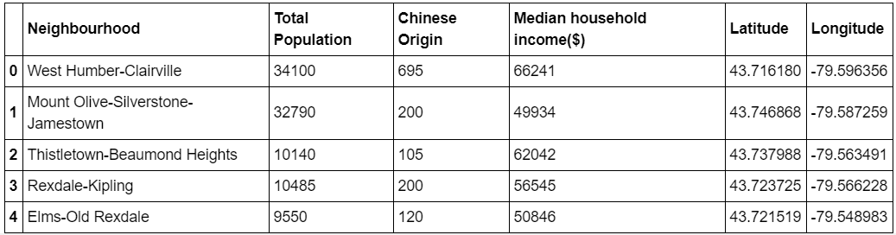
Toronto data for 140 neighbourhoods
The data for 140 neighbourhoods of the city of Toronto was sourced and combined to give the following data frame.

Slide 6
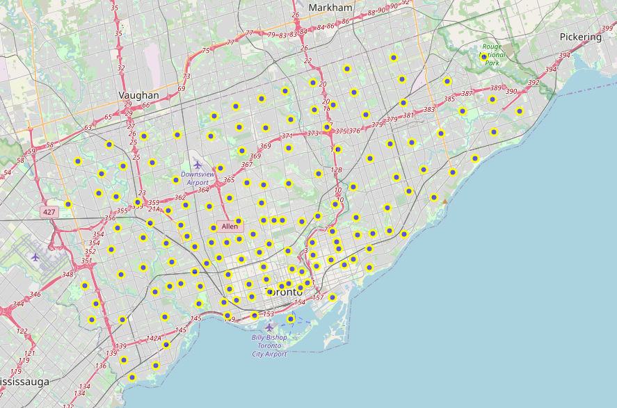
Toronto city map with neighbourhoods superimposed

Slide 7
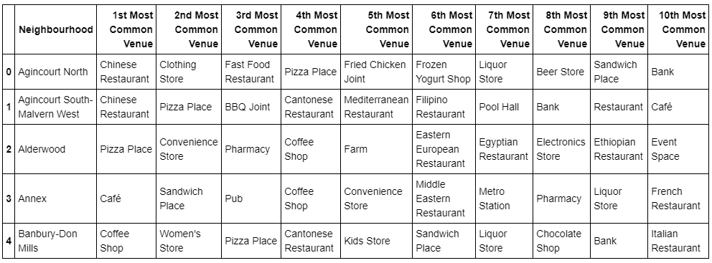
Neighbourhoods with top 10 most common venues
The data shows that most of the neighbourhoods have restaurants or cafes in their top 10 most common venues.
This insight shows a possible consumer behaviour and makes selecting a neighbour easier.
Also, the size of the data frame revealed that there were two neighbourhoods for which the Foursquare API did not return any venue.

Slide 8
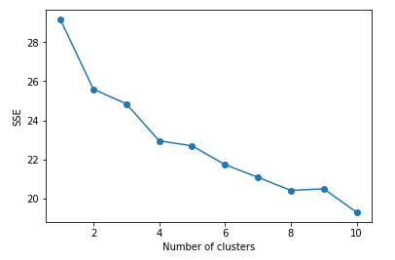
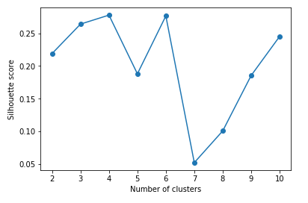
Finding the optimum value for k in k-means clustering
Elbow method
Silhouette method

Slide 9
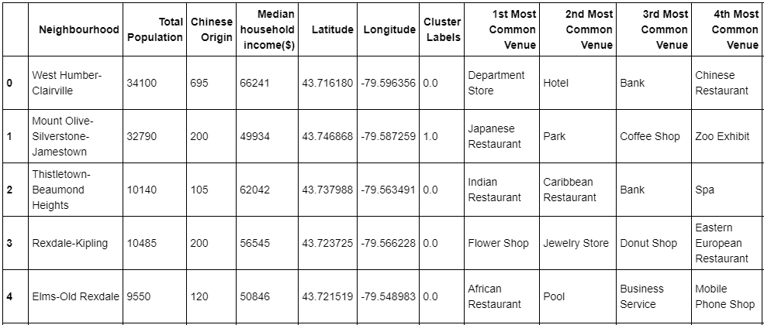
Neighbourhoods with cluster labels
The clustering of neighbourhoods using k-means based on venue data returned just 2 main clusters.
The target cluster contained the maximum number of neighbourhoods, 117 of the total 140, making it difficult to choose a neighbourhood right away.

Slide 10
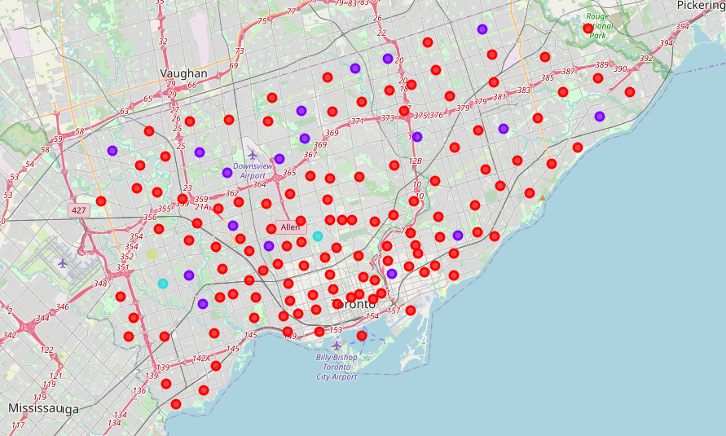
Toronto city map after clustering

Slide 11
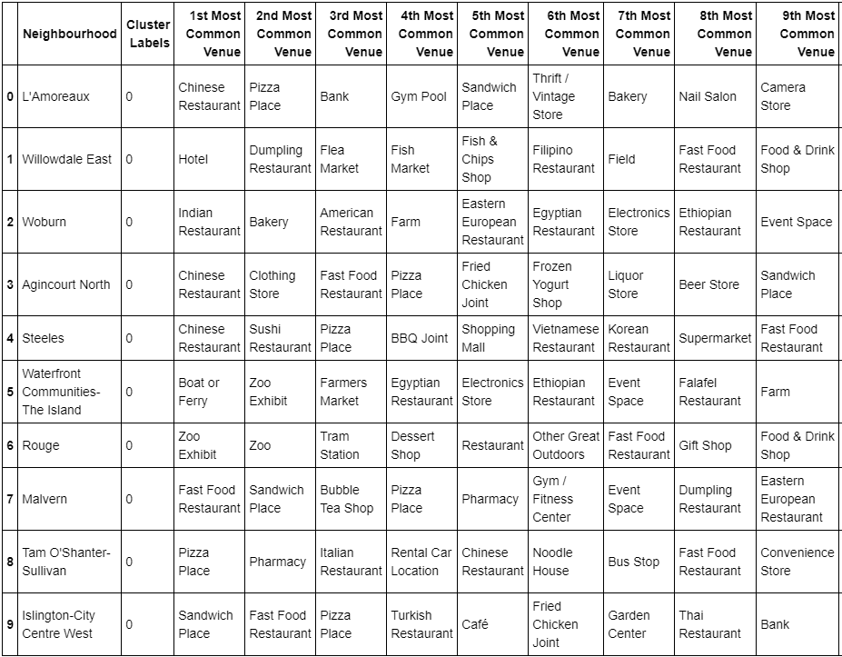
Top 10 recommended neighbourhoods
The Maple Leaf neighbourhood was found in Cluster 1 containing 116 other similar neighbourhoods.
A narrowed down list was obtained by combining the demographic and income data, with different weightage to different elements, to the resulting cluster.

Slide 12
Recommendations
Try using other clustering algorithms as well to see which generates more clusters with fewer neighbourhoods, if possible.
Use more relevant data, such as reviews and tips from the Foursquare API for venues in order to understand the preferences of the customers, to get an even precise outcome.

Slide 13
Conclusion
A reasonably good list of 10 neighbourhoods has been found to open a Chinese restaurant. To select one from this list, other criteria of choosing a location for a restaurant, such as available facilities/buildings in the neighbourhood, lease and rent terms, etc. can be used.
K-means clustering and Foursquare API are helpful tools to get a head start in such situations as discussed above, and saves a lot of time and resources for an organisation. It also becomes more visible in a clearer way by using visualisation tools, that how and why the choices made are relevant to the project.

